Slide 1

OneDelivery
Agentic AI for Customer Service
NUS ISS Practice Module | Architecting AI Systems • Team: Yihang Chia

Slide 2




Why OneDelivery
Problem
CS teams overwhelmed by repetitive refund, logistics, and order queries.
Manual resolution is slow, inconsistent, and hard to scale effectively.
Objective
Build a production-grade agentic AI system for autonomous interactions.
End-to-end flow: intent classification → action execution → QA.
Scope
12 microservices + 5 AI Agents.
Full E2E flow via RabbitMQ decoupling.
Deployed on AWS ECS Fargate with CI/CD pipeline.

Slide 3
How agents collaborate
Action Agent
via Guardian SOP gate
Logistics / Resolution
Execute Tool Actions
ACTION
Customer Message
Orchestrator Agent
Semantic Router
Intent Classification
FAQ
FAQ Agent
pgvector Semantic Search
QA Agent (Async Scoring)
Handoffs via RabbitMQ — No shared DB schema

Slide 4
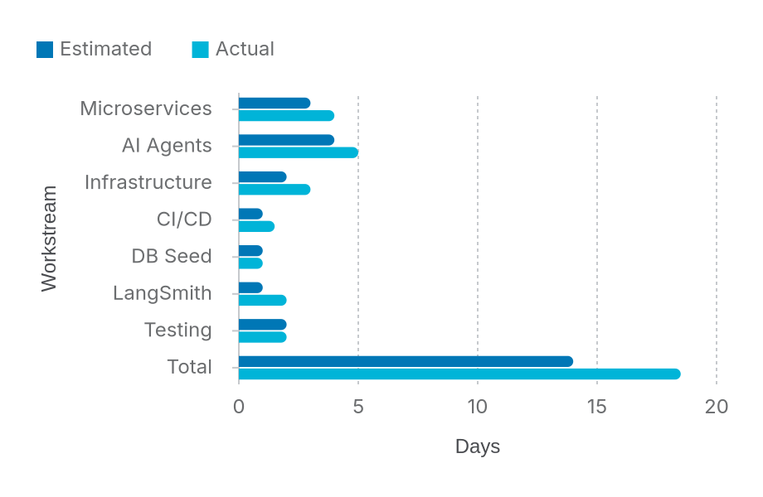
Effort to date
Key Overruns (~32%)
1. LangGraph Complexity
State machine transitions and deterministic routing logic required extra tuning.
2. AWS Networking
Pivoting from VPC Link to direct ALB DNS for internal routing caused delays.
3. ECS Exec Debugging
SSM permissions and policy configurations for production container access.

Slide 5
Logical architecture
Presentation: Browser / Mobile App + React SPA (GitHub Pages)
Gateway: HTTP REST API (CORS, JWT) + WebSocket API (JWT + RBAC authorizer)
AI Orchestration
Orchestrator Agent (LangGraph) • Privacy Service • Moderation Guard • Semantic Router
AI Agent Layer
Action (GPT-4o) • FAQ (GPT-4o-mini) • Logistics • Resolution • Guardian • QA
Domain Services
7 NestJS microservices + TypeORM schemas
Data & External
RabbitMQ • PostgreSQL 17 + pgvector • OpenAI
Key Patterns: Saga (Refund) • Publisher/Subscriber (RabbitMQ) • Chain of Responsibility

Slide 6
Physical architecture
1. Edge & Routing
HTTP Traffic
Browser → API GW → ALB → ECS (path-based routing)
WebSocket Traffic
Browser → WS API GW → Lambda Auth → RabbitMQ
2. Compute Layer
AWS ECS Fargate
12 Serverless Microservices
Agentic Handoff
Orchestrator → RabbitMQ → Specialist Agents
Guardian Gate
Resolution Agent ↔ Guardian compliance check
3. Data & Infra
Relational & Vector
RDS PostgreSQL 17 + pgvector (Private Subnets)
Supporting Infra
Amazon ECR CloudWatch SSM (ECS Exec)
Scale-to-zero capability • Isolated Data Schemas • No EC2 management overhead

Slide 7
Deployment strategy
Containerization
• Single Dockerfile template with build args (SERVICE_NAME, EXPOSE_PORT)
• 12 images built consistently
• Tagged with Git SHA and :latest
Deployment on AWS
• ECS Fargate scale-to-zero serverless containers
• Task definitions generated per service in CI/CD
• enable_execute_command = true for ECS Exec debugging
Rationale Behind Tech Choices
NestJS Monorepo: Shared libs, consistent DI, TypeORM per service schema.
RabbitMQ over REST: Decoupled async; agents don't block on domain services.
pgvector: Semantic search co-located with relational data; simpler ops.
API Gateway + ALB: Edge auth/CORS at the perimeter, robust path routing internally.

Slide 8
Tech stack
Layer | Technology
Backend Framework & ORM | NestJS (TypeScript) monorepo, TypeORM
AI / LLM & Vector | LangChain, LangGraph, GPT-4o, GPT-4o-mini, PostgreSQL 17 + pgvector
Event Bus | RabbitMQ (AMQP)
Cloud Infrastructure | AWS ECS Fargate, ALB, API Gateway v2, RDS, ECR
IaC & Local Gateway | Terraform, Kong
CI/CD & Security | GitHub Actions, Trivy (Container), SonarQube (SAST)
Observability | LangSmith (LLM Eval), CloudWatch
Auth | JWT (RS256), bcrypt

Slide 9
Orchestrator agent design
Purpose: Entry point and coordinator for the entire pipeline
1. ROUTE
• Receive via REST API
• Semantic Router (Intent)
2. ACT/FAQ
• Dispatch to Action/FAQ
• PII redaction first
• Moderation guards
3. GUARDIAN
• SOP compliance check
• Approve / Reject action
4. RESPOND
• Format reply
• Push to QA Agent async
Memory Model
MemoryService maintains conversation history per sessionId (in-memory).
Available Tools
Route_To_Logistics • Route_To_Resolution
End_Chat_Session • Escalate_To_Human

Slide 10
Specialist agents
Logistics Agent
• Tracking, ETA, and delay prediction
• GPT-4o; queries Logistics service via RabbitMQ
• Memory: Stateless
• Tools: Get_Order_Status, Get_Shipment_ETA, Predict_Delay
Resolution Agent
• End-to-end refunds grounded by SOPs (pgvector)
• Returns structured JSON: status, orderId, amount, summary
• Auto-approves ≤ $20 refunds
• Escalates amounts > $20 to Guardian
Guardian Agent
• SOP compliance gate for all actions
• Approves or rejects with detailed explanation
• Limits to 3 rejection cycles → then human escalation
QA Agent
• Async post-session scoring
• Evaluates: accuracy, SOP compliance, sentiment, quality
• Aggregates trends via scheduled cron job

Slide 11
Production readiness
MLSecOps / LLMSecOps Pipeline
1. CI & Eval
• Trivy scan, ESLint, SonarQube SAST
• LangSmith eval gates (Orchestrator, QA, Guardian)
Testing Summary
Unit/Integration: Jest & Supertest passing
Security: No critical CVEs (Trivy), no SAST blockers (SonarQube)
LangSmith Evals: Verified routing accuracy, Guardian compliance, QA consistency, Resolution JSON formatting
2. Build & Push
• Build 12 microservice images
• Tag with Git SHA + :latest, push to ECR
Live Demo Flow
1. Login & Start Chat
2. Refund Request → ACTION route → Resolution Agent
3. Guardian Agent approves action
4. Refund JSON returned → QA Agent scores async
3. Deploy
• Generate ECS task definitions
• Matrix deploy to Fargate with force-new

Slide 12
Responsible AI & Security
Explainable & Responsible
• Explainability: JSON includes decision summaries
• Fairness: Decisions grounded in SOPs, not LLM opinion
• Privacy: Redaction of name/email/phone/NRIC
• Human in Loop: Guardian gate & escalation paths
• Transparency: Full LangSmith traces and audit trails
AI Security Guardrails
• Jailbreak / Prompt Injection: Moderation service + prompt isolation
• Hallucinations: pgvector SOP grounding
• Excessive LLM Authority: Strict tool-based limits
• Secrets & Rate Limits: AWS Secrets Manager, API Gateway rate limits
Thank you
Agentic AI with deterministic guardrails — production-grade on AWS Fargate

